Slide 1
FUTURE WORTH METHOD
Chapter 5

Slide 2
FUTURE WORTH METHOD
In the future worth method of comparison of alternatives, the future worth of various alternatives will be computed.
Then, the alternative with the maximum future worth of net revenue or with the minimum future worth of net cost will be selected as the best alternative for implementation.

Slide 3
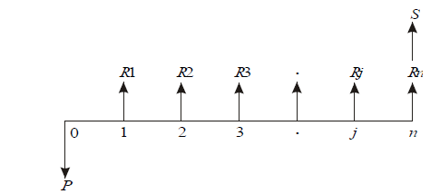
REVENUE-DOMINATED CASH FLOW DIAGRAM
A generalized revenue-dominated cash flow diagram to demonstrate the future worth method of comparison

Slide 4
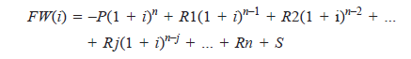
The formula for the future worth of the above cash flow diagram for a given interest rate, i is

Slide 5
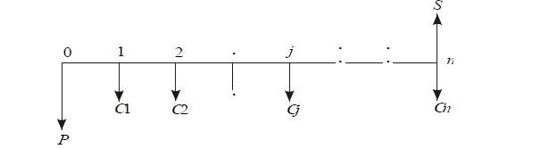
COST-DOMINATED CASH FLOW DIAGRAM
A generalized cost-dominated cash flow diagram to demonstrate the future worth method of comparison is given in Fig

Slide 6
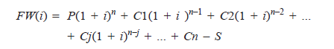
The formula for the future worth of the above cash flow diagram for a given interest rate, i is:
In this formula, the expenditures are assigned with positive sign and revenues with negative sign.

Slide 7
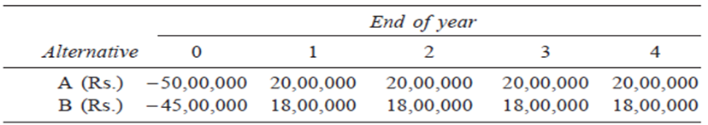
Example 1
Consider the following two mutually exclusive alternatives:
At i = 18%, select the best alternative based on future worth method of comparison.

Slide 8
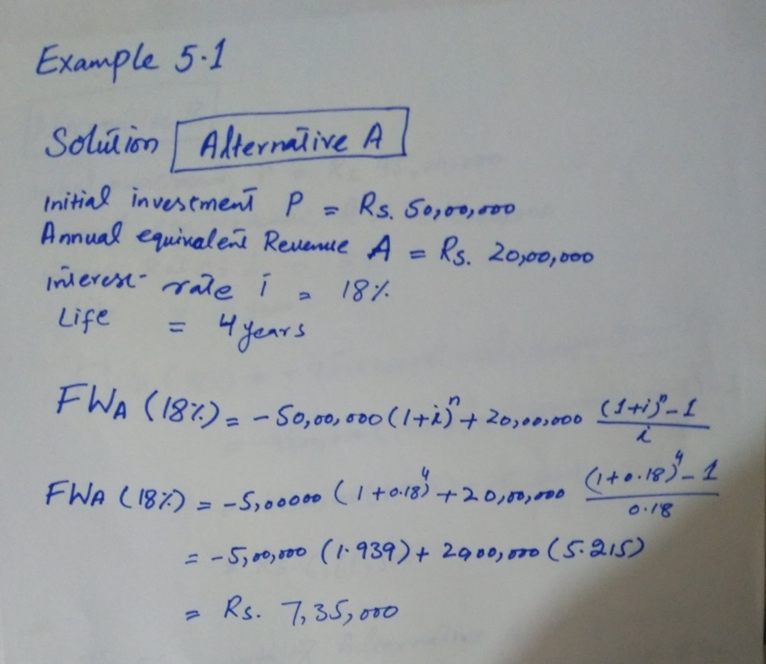

Slide 9
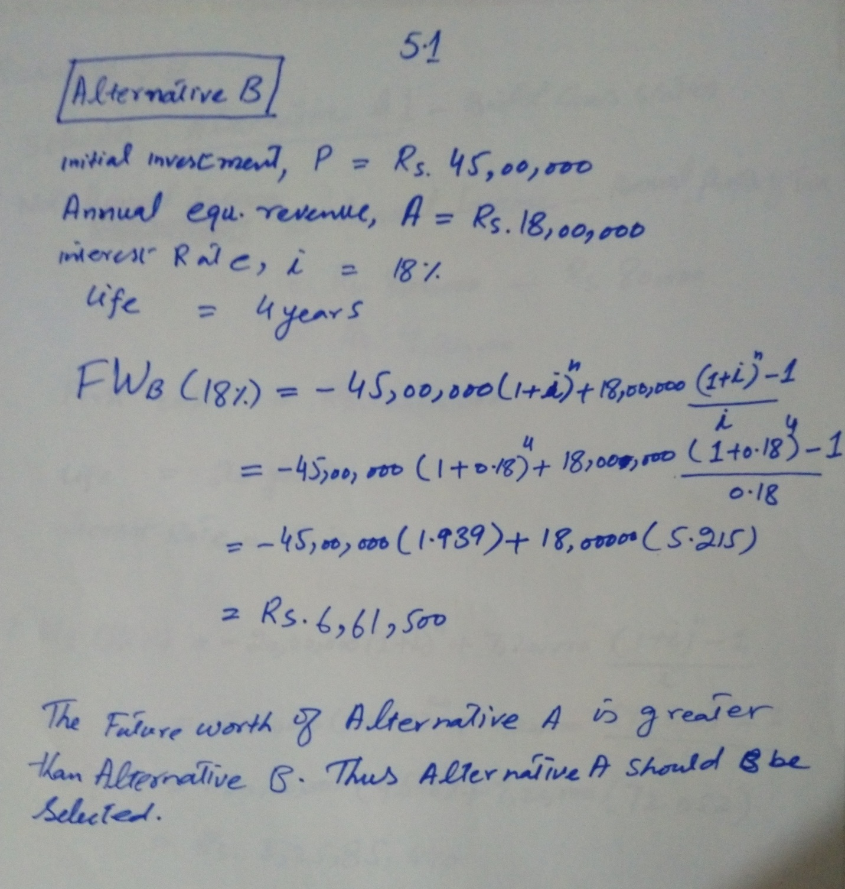

Slide 10
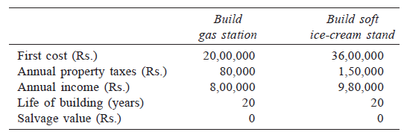
Example 2
A man owns a corner plot. He must decide which of the several alternatives to select in trying to obtain a desirable return on his investment. After much study and calculation, he decides that the two best alternatives are as given in the following table:
Evaluate the alternatives based on the future worth method at i = 12%.
Notes:
Salvage value is the value of machine at the end i.e. after 20 years In this example.

Slide 11
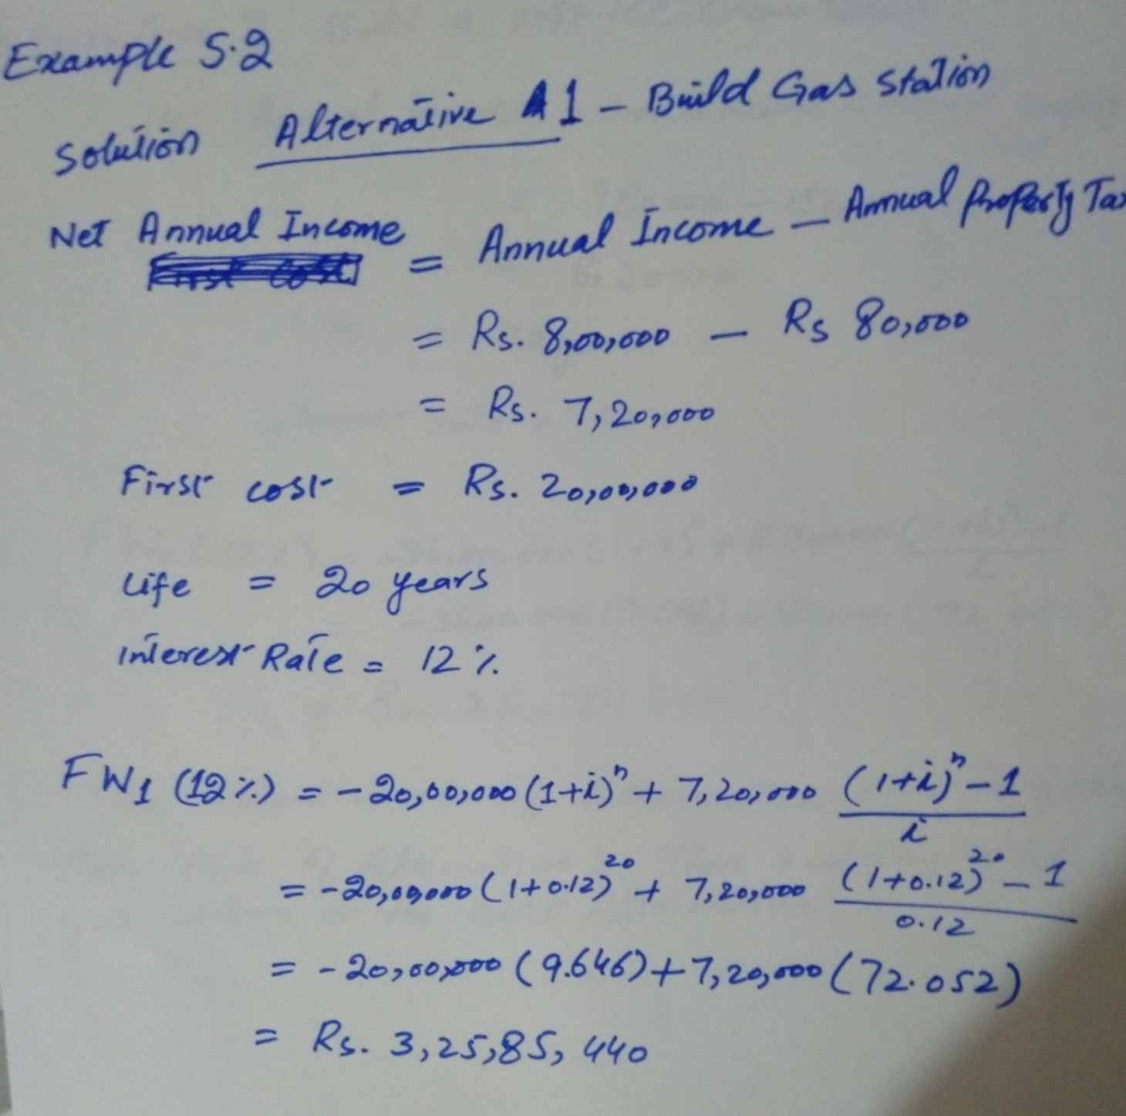

Slide 12
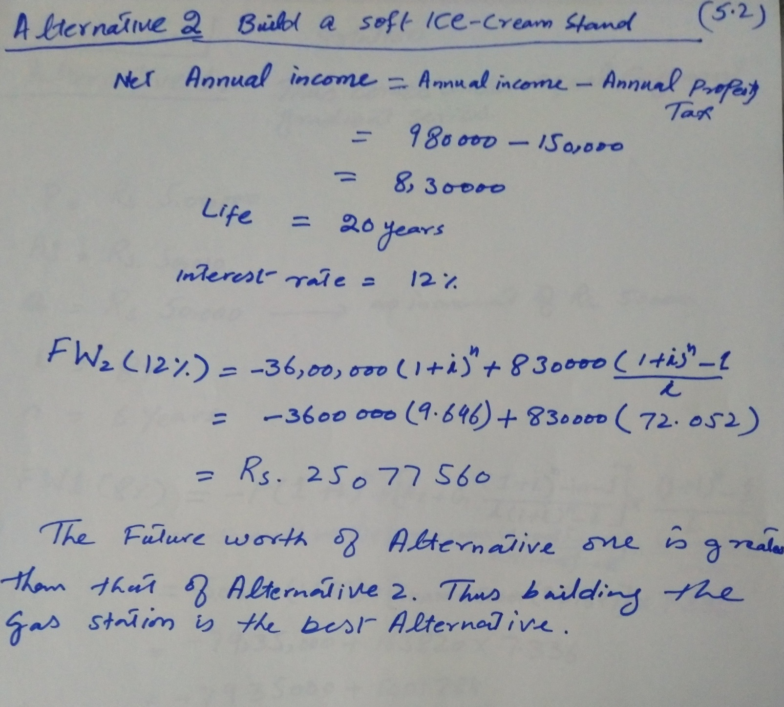

Slide 13
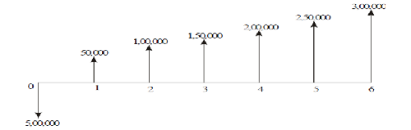
Chapter 5 (continue) Example 3
The cash flow diagram of two mutually exclusive alternatives are given in the Figure:
Alternative 1

Slide 14
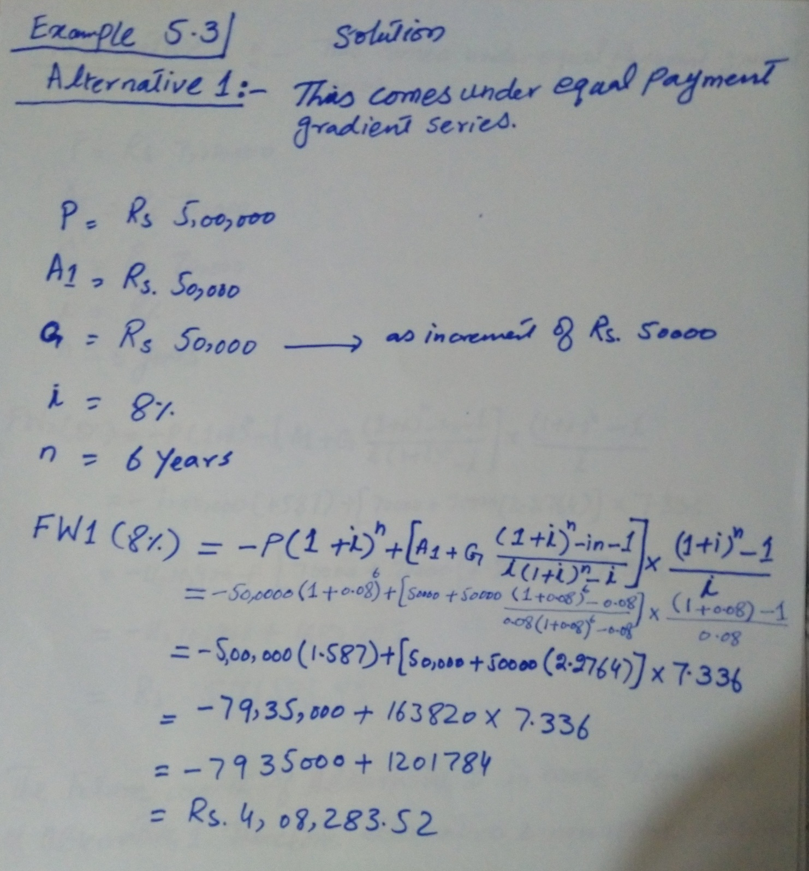

Slide 15
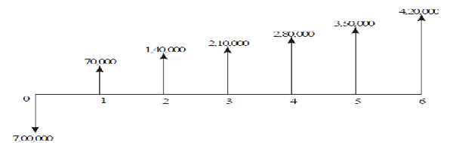
Alternative 2
Select the best alternative based on future worth method at i = 8%.
Notes:
Rework part (a) with i = 9% and 20% is your assignment 2

Slide 16
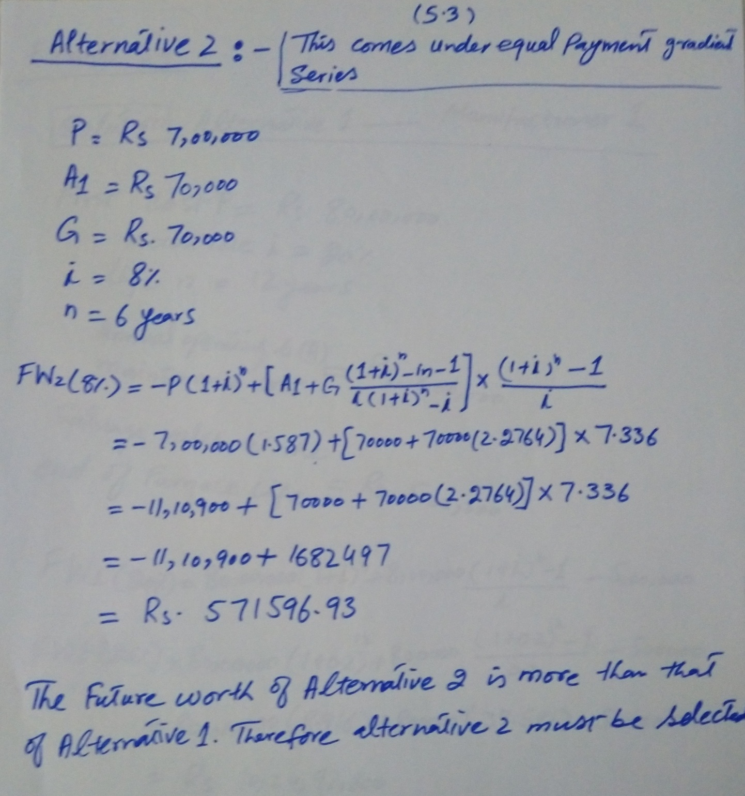

Slide 17
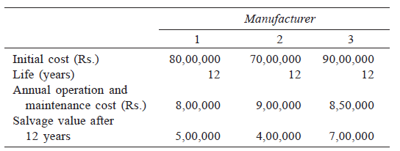
Example 4
M/S Krishna Castings Ltd. is planning to replace its annealing furnace. It has received tenders from three different original manufacturers of annealing furnace. The details are as follows.
Which is the best alternative based on future worth method at i = 20%?

Slide 18
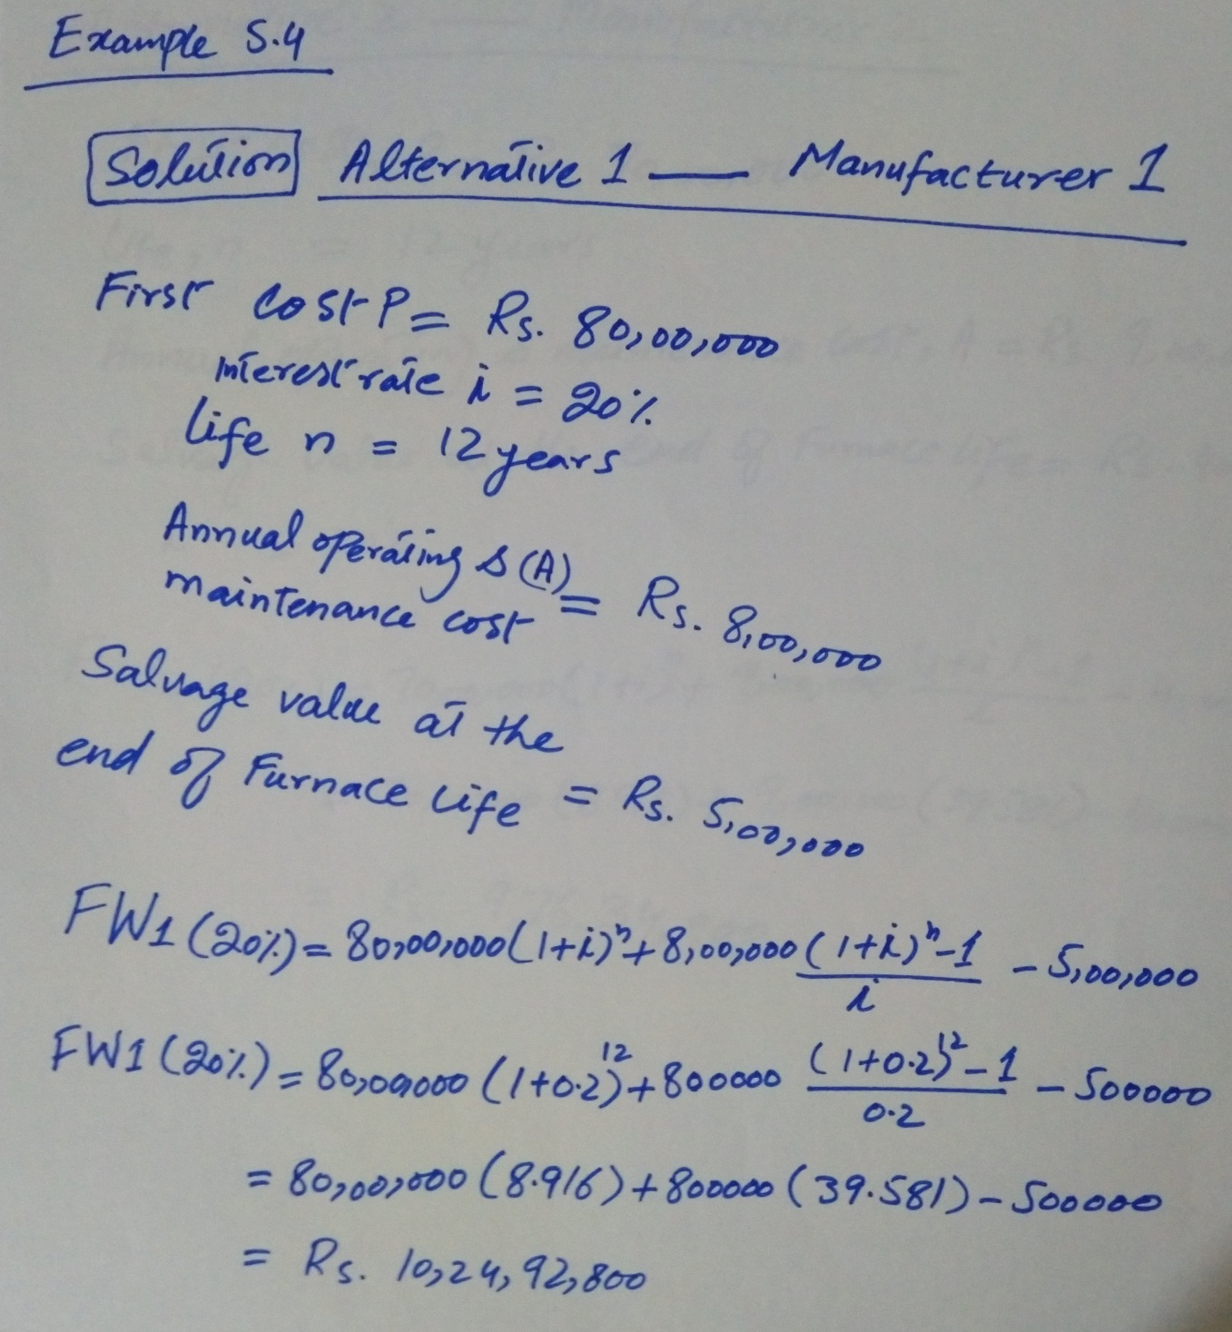

Slide 19
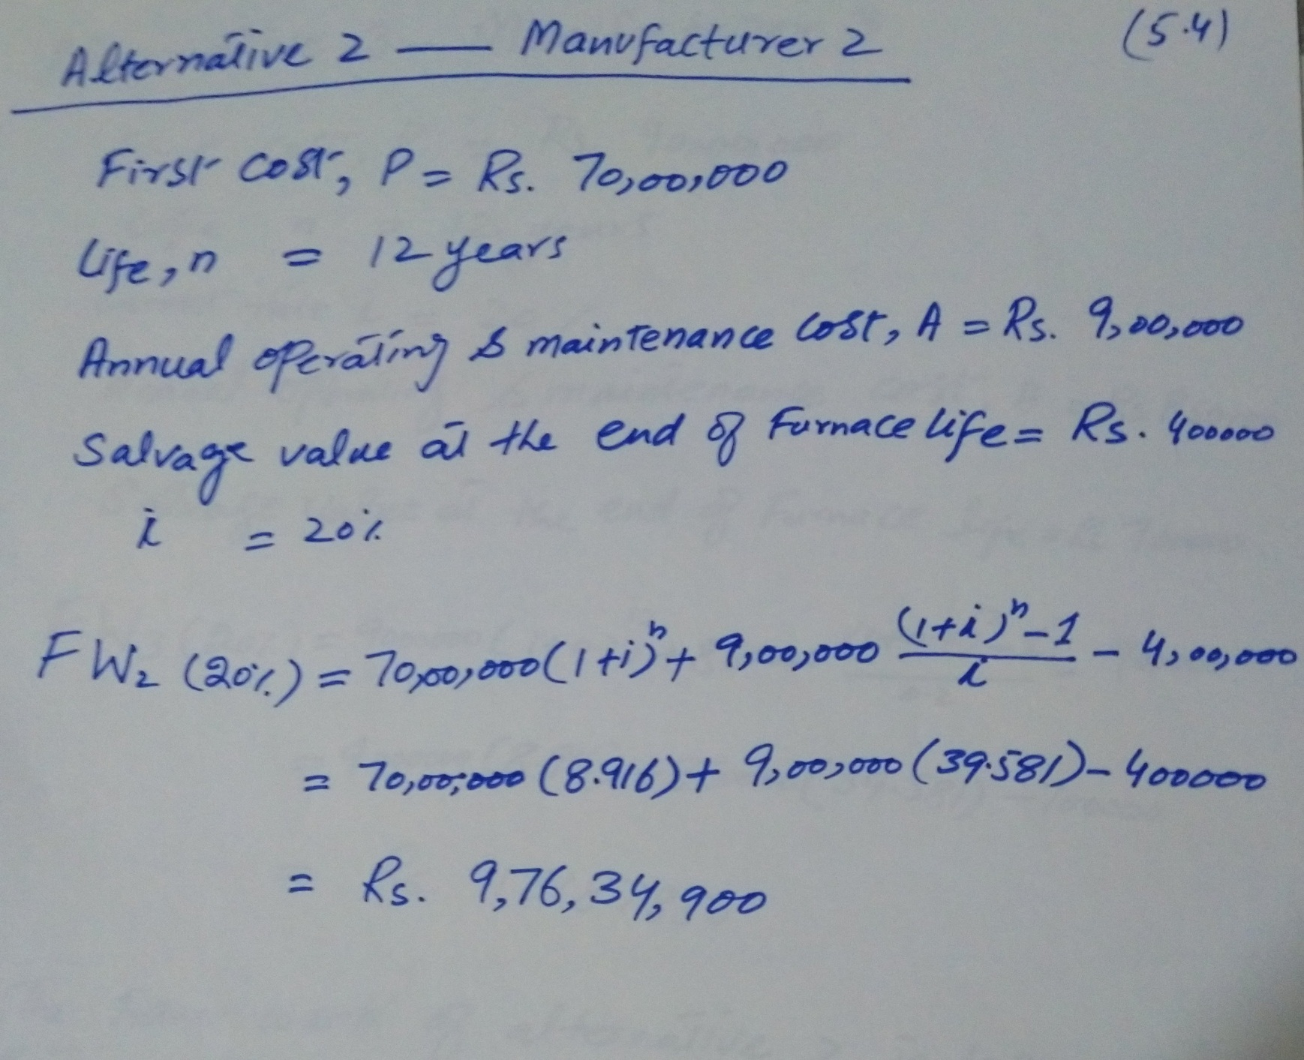

Slide 20
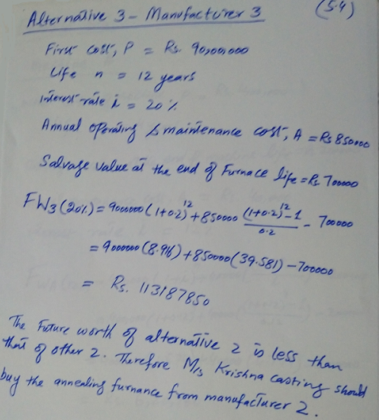

Slide 21
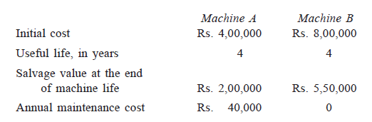
Example 5
A company must decide whether to buy machine A or machine B:
At 12% interest rate, which machine should be selected? (Use future worth method of comparison).

Slide 22
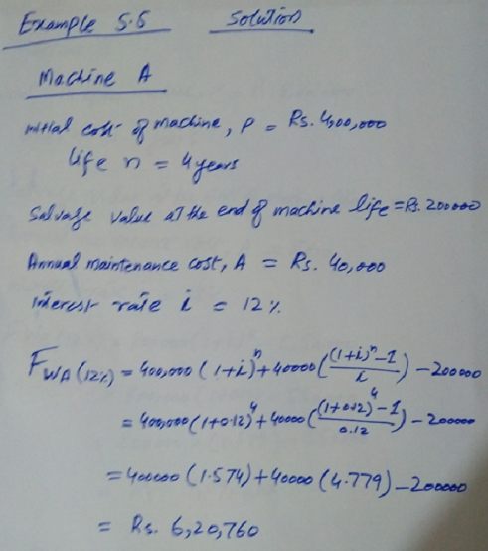

Slide 23
